Slide 1

Probability Basics
Chapter 5

Slide 2
Objectives
Read sections 5.1 – 5.4.
Understand the meaning of probability and other vocabulary words.
Know the proper notation for probabilities, sample spaces, and models.
Calculate basic probabilities from a sample or population.
Know how and when to use the addition rule.
Solve problems from a contingency table.
Understand mutual exclusivity.
Find the complement of an event and its probability.
Calculate conditional probabilities.
Differentiate between dependence and independence.
Use the general multiplication rule appropriately.
Understand how to use the principle of counting.
Know the difference between combinations and permutations.

Slide 3
A Probability Experiment
Why do we flip a coin to decide which team gets the ball first in a football game?
It’s fair because:
a. It’s unpredictable. We can never know with certainty how the coin will land.
b. Over the long run, it ensures that each team will begin the game about half of the time.
In a probability experiment, such as a coin toss, we do not know what the outcome will be for an individual experiment.
But we do know the outcome of a long series of repeated experiments.
The probability of an event is the proportion of times the event occurs in the long run (as the experiment is repeated many times).

Slide 4
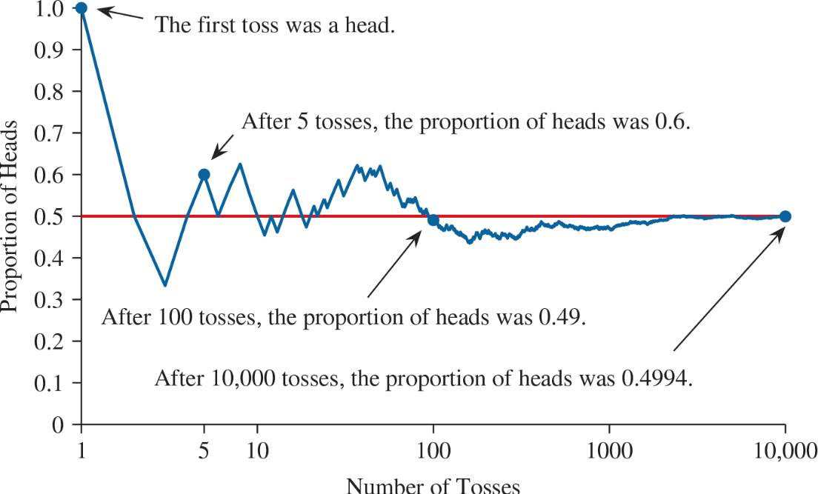
The Law of Large Numbers
The Law of Large Numbers:
As a probability experiment is repeated, the proportion of times that an event occurs approaches the probability of said event.
Activity: Adjustable Spinner
Kerrich Wikipedia Link

Slide 5
Review: Relative Frequency
Florida Sanctuary for Reptiles & Amphibians
Animal | Frequency | Relative Frequency (decimal) | Relative Frequency (percentage)
Alligator | 4 | 0.16 | 16%
Frog | 6 | 0.24 | 24%
Snake | 4 | 0.16 | 16%
Turtle | 11 | 0.44 | 44%
TOTAL | 25 | 1.00 | 100%
Numerically, relative frequency = proportion = probability.
We state probabilities as a decimal (round to four places).
We state chances as a percentage.
For example, “There is a 65% chance of rain today” = “The probability that it will rain today is 0.65.”

Slide 6
Sample Space
A sample space contains all the possible outcomes of a probability experiment.
S = { … }
Define the sample space for each scenario.
1. We randomly select a single digit from 0 through 9. S = {0, 1, 2, 3, 4, 5, 6, 7, 8, 9}
2. We flip a fair coin once.
3. We roll a fair 6-sided die once.
4. We randomly select one season of the year.

Slide 7
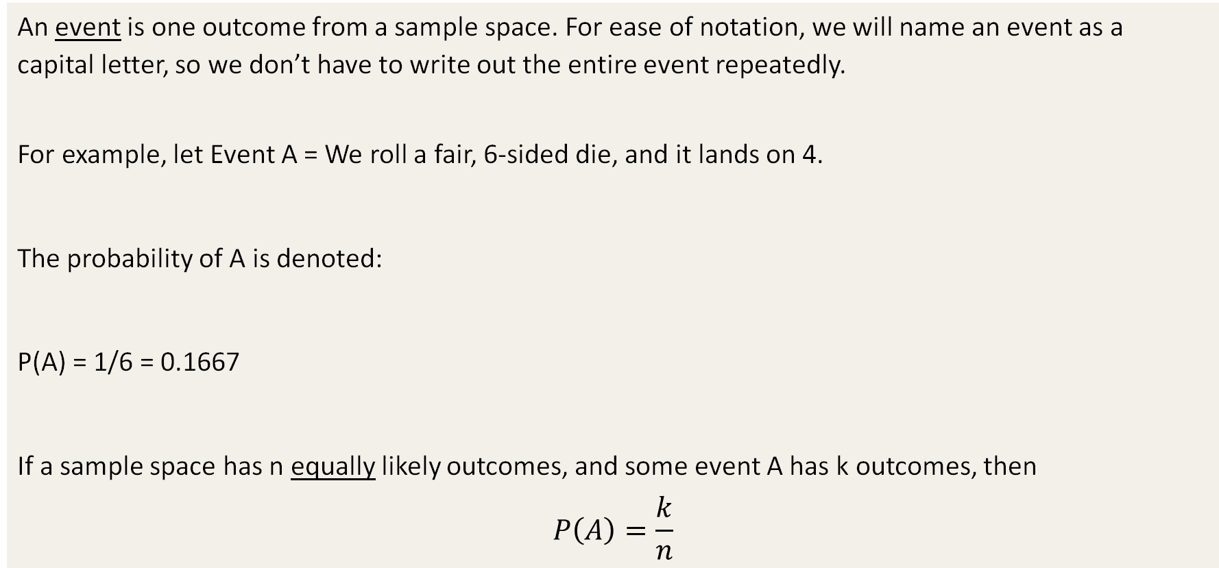
Event
An event is one outcome from a sample space. For ease of notation, we will name an event as a capital letter, so we don’t have to write out the entire event repeatedly.
For example, let Event A = We roll a fair, 6-sided die, and it lands on 4.
The probability of A is denoted:
P(A) = 1/6 = 0.1667
If a sample space has n equally likely outcomes, and some event A has k outcomes, then
$$P\left(A\right)=\frac{k}{n}$$

Slide 8
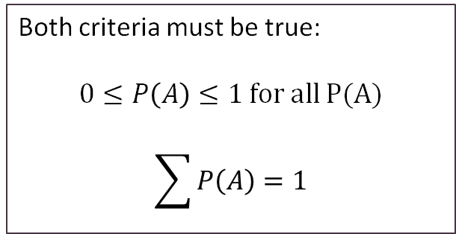
Probability Models
A probability model is a table that shows every event in a sample space and their respective probabilities. Example Probability Model: The marital status of a sample of people.
Marital Status | Never Married | Married | Widowed | Divorced
Probability | 0.386 | 0.555 | 0.004 | 0.055
Both criteria must be true:
$0≤P\left(A\right)≤1 for all P(A)$
$$\sum{P\left(A\right)}=1$$
X | Never Married | Married | Widowed | Divorced
P(X) | 0.386 | 0.555 | 0.004 | 0.055
For a probability model to be legitimate,
1. Each probability must be between 0 and 1.
2. The sum of the probabilities must equal 1.

Slide 9
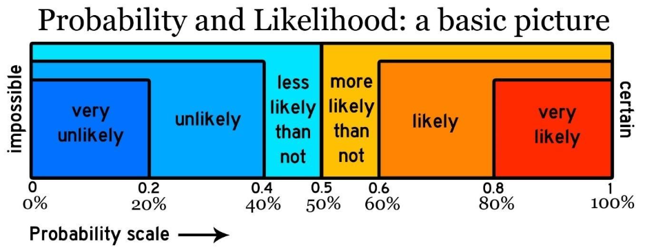
Interpreting Probabilities
The probability of any event is always between 0 and 1.
A probability can NEVER be less than 0 or greater than 1.
If event A cannot occur, then P(A) = 0. If event A is certain to occur, then P(A) = 1.
Unusual event: one whose probability is less than 0.05 (or 5%).

Slide 10
Interpreting Probabilities Practice
Can you think of an event with a probability of 1?
Can you think of an event with a probability of 0?
Describe this probability with words: 0.0002
Describe this probability with words: 0.8749
Describe this probability with words: 0.0392
Describe this probability with words: 0.9975
Describe this probability with words: 0.5786

Slide 11
Sampling from a Population
A certain town has 10,000 families. This table organizes them by their type of housing.
If we select one family at random,
what is the probability that the family…
Owns a condo?
Rents an apartment?
Owns?
Rents?
Lives in a house?
Housing Type | Frequency
Own a House | 4,753
Own a Condo | 1,478
Rent a House | 912
Rent an Apartment | 2,857
TOTAL | 10,000

Slide 12
The Empirical Method
The Empirical Method is a way to repeat a probability experiment many times to approximate the probability of an event. The more replications of the experiment, the more reliable the approximation will be.
Example: The CDC reports that in a recent year:
313,752 babies were born with low birth weight (less than 2500 grams).
3,477,960 babies were born with weight greater than 2500 grams.
Use this data to approximate the probability that a baby will be born with low birth weight.
What is the probability that a baby will not have a low birth weight?

Slide 13
More Practice
We want to randomly select one weekday to plan a faculty meeting. What is the sample space?
We randomly select one month from the calendar. What is the probability that the month we select will have more than 30 days?
Which of the following probabilities are valid?
0.0142 -0.2258 1.7420 0.9999 1/33 112% 88/70 0.05%
In a magic hat, there are 5 white rabbits, 2 black rabbits, 3 spotted rabbits, and 4 brown rabbits. If a magician randomly pulls one rabbit out of the hat, what is the probability that… The rabbit will be brown?
The rabbit will be brown or white?
The rabbit will not be spotted?
The rabbit will be black or spotted?

Slide 14
Compound Events
A compound event is simply a combination of two or more events.
The symbol ∪ means “union.”
The symbol ∩ means “intersection.”
P(A or B) = P(A∪B)
*A or B or both
P(A and B) = P(A∩B)

Slide 15
The General Addition Rule
P(A∪B) = P(A) + P(B) − P(A∩B)
Example: The probability that I will work on a project today is 0.3539. The probability that I will take a nap today is 0.2876. The probability that I will both work on a project and take a nap today is 0.1899.
What is the probability that I will work on a project or take a nap?
P(P∪N) = 0.3539 + 0.2876 – 0.1899 = 0.4516
Pay close attention to keywords “and” & “or.”

Slide 16
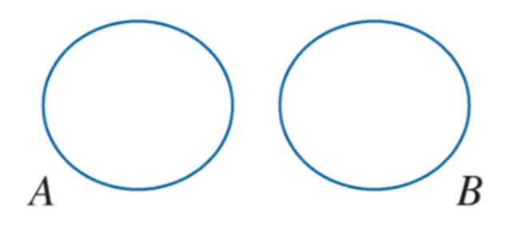
Mutually Exclusive Events
If two events are mutually exclusive, that means the occurrence of one event makes it impossible for the other event to occur. Both events will never be true at the same time. There is no “overlap.” There is no shared sample space. Example of mutually exclusive events:
Today is Wednesday and today is Friday.
If A and B are mutually exclusive, then:
P(A ∪ B) = P(A) + P(B)
This is the addition rule for mutually exclusive events.
Why does this formula make sense?

Slide 17
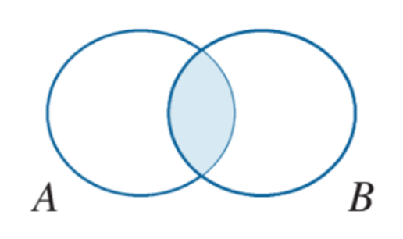
NOT Mutually Exclusive Events
If two events are NOT mutually exclusive, then it is possible for both events to be true. In other words, they do share a sample space. The shaded area in the Venn diagram represents the probability that both A and B occur.
Example of events that are NOT mutually exclusive:
Today is Friday and it’s raining.
Are two events mutually exclusive?
How to solve mathematically:
P(A) = 0.7 P(B) = 0.2 P(A ∪ B) = 0.8
Are A and B mutually exclusive?
P(A ∪ B) = P(A) + P(B) … is this statement true here?

Slide 18
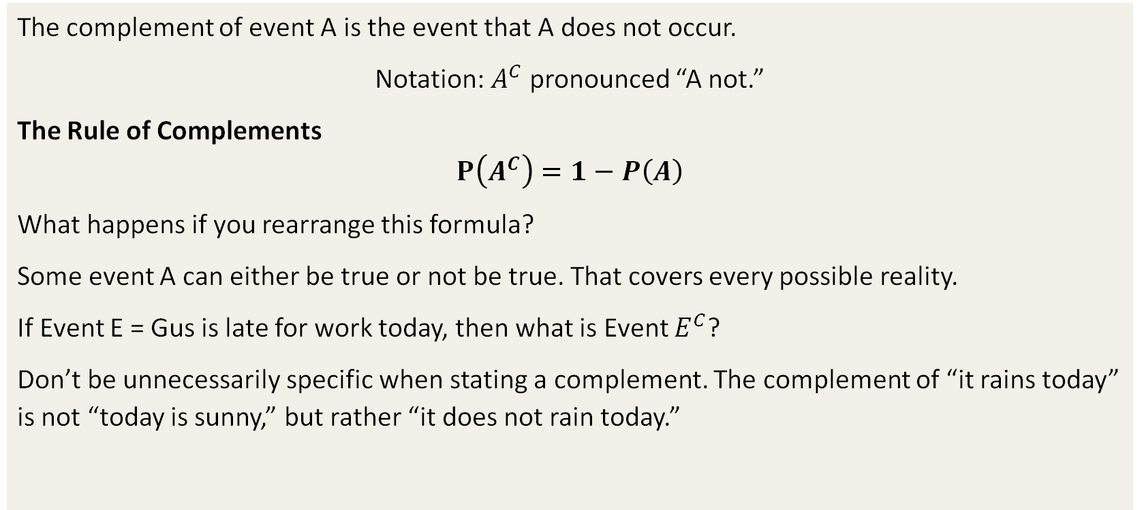
Complements
The complement of event A is the event that A does not occur.
Notation: $A^{C}$ pronounced “A not.”
The Rule of Complements
$$P\left(A^{C}\right)=1−P\left(A\right)$$
What happens if you rearrange this formula?
Some event A can either be true or not be true. That covers every possible reality.
If Event E = Gus is late for work today, then what is Event $E^{C}$?
Don’t be unnecessarily specific when stating a complement. The complement of “it rains today” is not “today is sunny,” but rather “it does not rain today.”

Slide 19
How to Make A Probability Tree
A commuter passes through two traffic lights on the way to work. Each light is either red, yellow, or green. Let the probability experiment be that we observe the colors of the two lights. *Let’s use the probability tree technique to help us make a sample space.
What is the sample space?
Let event A be that both colors are the same. What are the outcomes of event A?
Let event B be that the colors are different. What are the outcomes of event B?
Event C is that at least one of the lights is green. What are the outcomes of event C?
Are events A and B mutually exclusive?
Are events A and C mutually exclusive?

Slide 20
Drawing a Probability Tree

Slide 21
Conditional Probability
A conditional probability is computed with the knowledge that some previous event is true or has already occurred.
Sometimes we want to narrow down our sample space to a more specific list of simple events within that sample space; this “narrowing down” is our condition. For example,
Event A = Alice is late for a meeting.
Event B = It’s raining.
Does P(A) change depending on Event B? In other words, is Alice more or less likely to be late given that it’s raining?
P(A|B) = “the probability of A, given B”
Whatever is “given” is the condition (the new set of circumstances). For example,
P(A|B) = P(“Alice is late” | “it’s raining”)
P(A|B) = P(A∩B) / P(B)
P(B|A) = P(A∩B) / P(A)
Never assume that P(A|B) = P(B|A).
The condition = what is given = the new denominator.

Slide 22
The General Multiplication Rule
To find the probability that two or more events are true, we must multiply the individual probabilities together.
For example, the probability that events C, D, and E occur = P(C) x P(D) x P(E).
The equations will change depending on whether the events are independent or dependent.
Two events are dependent if the occurrence of one event changes the probability that the other event will occur.
P(A∩B)=P(A)∗P(B|A)
P(A∩B)=P(B)∗P(A|B)
Two events are independent if the occurrence of one event does not change the probability that the other event will occur.
(A∩B)=P(A)∗P(B)
Example:
Event A = There is a severe storm in the Atlanta area.
Event B = KSU cancels classes for the day.
Event C = Your best friend wins the lottery.
Do you think events A and B are independent?
Do you think events A and C are independent?

Slide 23
Are Two Events Independent?
Does P(A) = P(A|B)?
Does P(B) = P(B|A)?

Slide 24
Mutually Exclusive vs. Independent
Does the occurrence of one event prevent the other event form occurring?
Does the occurrence of one event change the probability of the other event?
If two events are mutually exclusive, MUST they be independent or dependent?
True or false: Not all dependent events are mutually exclusive.

Slide 25
Contingency Tables
Contingency tables categorize items by two variables. In this table below, what are the two variables represented?
Solving problems from a contingency table:
Find the totals for each row and each column.
The row totals and column totals should add up to the same “grand total.”
Use the general addition rule for “or” problems.
The keyword “and” means to find the intersection.
Voter Information
 |  | Opinion
 |  | Favor | Opposed | Undecided | Totals
Likelihood to Vote | Likely | 372 | 262 | 87 | 721
 | Not likely | 151 | 103 | 25 | 279
 | Totals | 523 | 365 | 112 | 1,000

Slide 26
Contingency Table Practice
Example: If we randomly select one person from the table, what is the probability that they…
Favor the proposal?
Are not likely to vote?
Are undecided and likely to vote?
Are undecided or opposed?
Are opposed or not likely to vote?
Are in favor and opposed?
Are likely to vote given that they are opposed?
Are opposed given that they are likely to vote?
Voter Information
 |  | Opinion
 |  | Favor | Opposed | Undecided | Totals
Likelihood to Vote | Likely | 372 | 262 | 87 | 721
 | Not likely | 151 | 103 | 25 | 279
 | Totals | 523 | 365 | 112 | 1,000

Slide 27
Sampling With vs. Without Replacement
When we select an item from a sample, we have two choices: either we replace the item before the second selection, or we do not. This choice will change the probabilities associated with the subsequent selection.
Example: In one hand, Smaug holds 15 rubies, 12 diamonds, 22 gold coins, and 9 emeralds.
If he randomly selects one treasure, what is the probability that it will be a diamond?
What is the probability that it will be an emerald or a ruby?
If he replaces each treasure after selecting it, what is the probability that he will select a gold coin, then an emerald, and then a diamond?
If he throws each gem over his shoulder after selecting, what is the probability that he will select a ruby and then a diamond?
If he throws each gem over his shoulder after selecting, what is the probability that he will select 3 emeralds in a row?

Slide 28
Sampling from Large Populations
If we select items from a large population, then sampling with replacement does not matter.
If the sample size is less than 5% of the population, then we can treat all sampled items as independent.
n < 0.05*N
N > 20*n
For example, let’s say Jesse wins the lottery this month and he doesn’t play anymore. Does that change the probability that the next lottery winner will be Walter? (Assume roughly 173,000,000 people play the lottery.)

Slide 29
“At Least One” Problems
If a word problem asks for the probability of “at least one” something, there is a shortcut to solving it.
Let’s revisit the probability tree to illustrate this concept.
Example: Harvey flips an unfair coin 3 times. (It’s weighted to favor one side.) The probability that it will land heads up is 0.55. What is the probability that it will land heads up at least once? Make a probability tree.

Slide 30
“At Least One” Problems – Probability Tree

Slide 31
“At Least One” Problems, continued
If a word problem asks for the probability of “at least one” something, there is a shortcut to solving it.
Let’s revisit the probability tree to illustrate this concept.
Example: Harvey flips an unfair coin 3 times. (It’s weighted to favor one side.) The probability that it will land heads up is 0.55. What is the probability that it will land heads up at least once? Make a probability tree.
Solve the same problem with this faster method:
P(at least one) = 1 – P(none)
1 – P(tails)^3 = 1 – (0.45)^3 = 0.9089

Slide 32
The Fundamental Principle of Counting
If one operation can be performed m ways, and the 2nd operation can be performed n ways, then the total number of ways to perform the sequence of those two operations is m*n.
We can extend this rule for any number of operations.
For example: How many unique lunch orders can we make?
On the menu, we have 5 sandwiches to choose from,
4 kinds of chips,
3 kinds of cookies,
And 6 kinds of beverages.
If we choose one item per category, how many unique lunches can we make?
= 5*4*3*6 = 360 unique lunches

Slide 33
The Fundamental Principle of Counting Practice
Practice: It’s time to plan an outfit for a job interview. In your closet, you have 5 shirts, 3 pairs of slacks, 2 pairs of shoes, 3 ties, and 2 blazers to choose from.
How many unique outfits can you make?
You decide to skip the blazer because it’s summertime. How many outfit choices does this leave you with?
You then decide that you must wear your favorite shirt and tie. With this decision made, how many different outfits can you build from there?

Slide 34
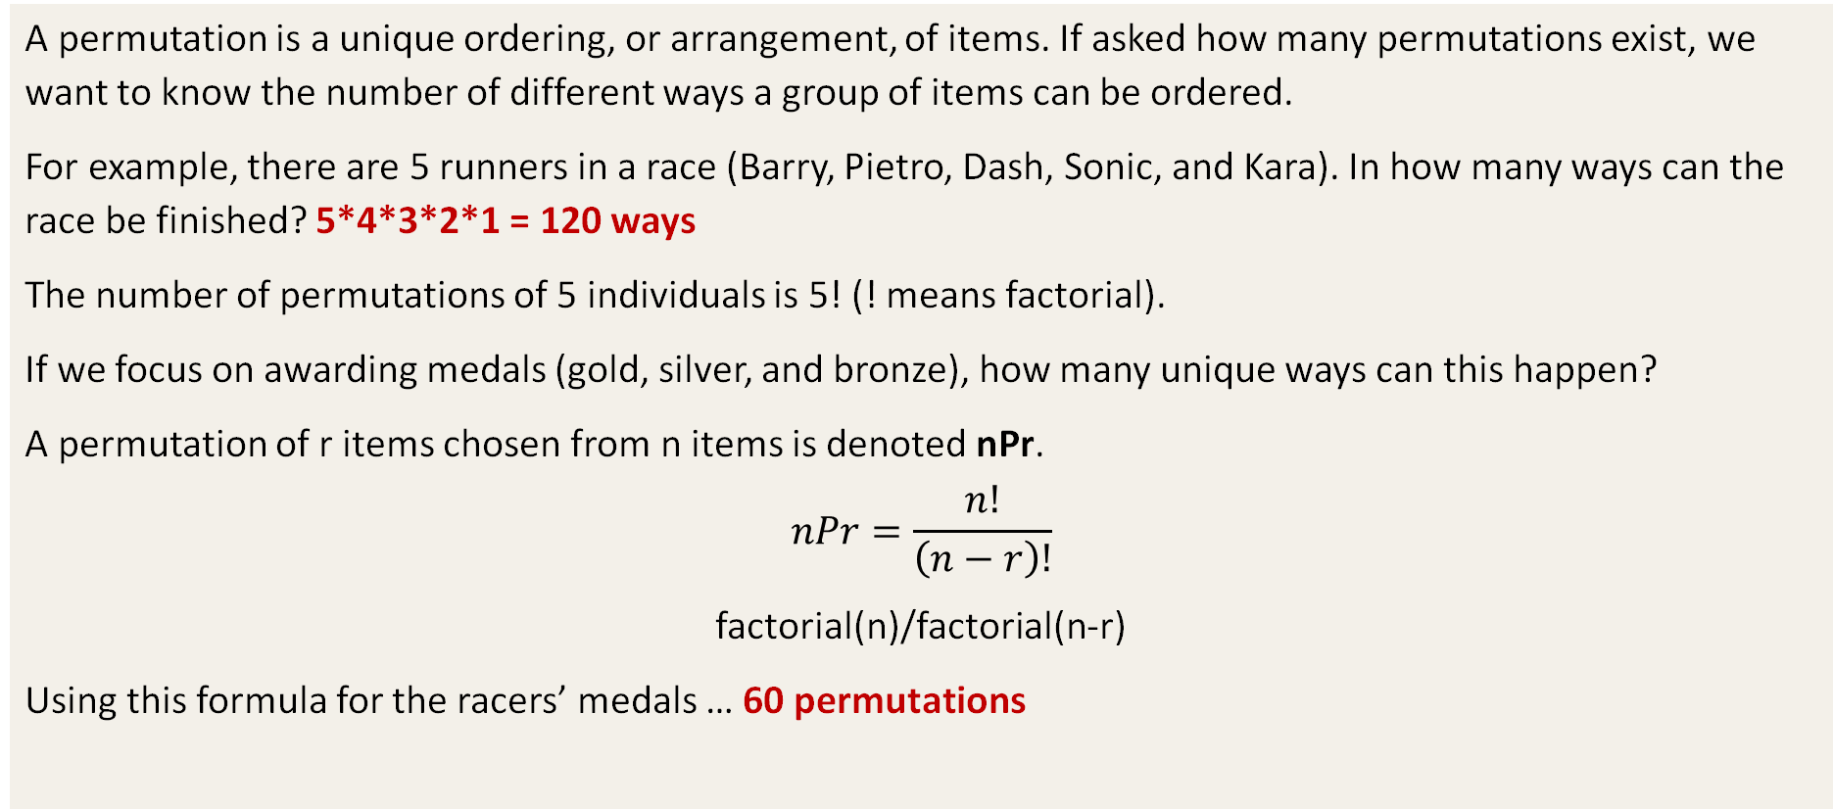
Permutations
A permutation is a unique ordering, or arrangement, of items. If asked how many permutations exist, we want to know the number of different ways a group of items can be ordered.
For example, there are 5 runners in a race (Barry, Pietro, Dash, Sonic, and Kara). In how many ways can the race be finished? 5*4*3*2*1 = 120 ways
The number of permutations of 5 individuals is 5! (! means factorial).
If we focus on awarding medals (gold, silver, and bronze), how many unique ways can this happen?
A permutation of r items chosen from n items is denoted nPr.
$$nPr=\frac{n!}{\left(n−r\right)!}$$
factorial(n)/factorial(n-r)
Using this formula for the racers’ medals … 60 permutations

Slide 35
Permutations Practice
Practice: There’s a team of 12 people at work, and 3 employees are needed to work late today. No one really wants to work late, so they decided to choose people at random. Someone needs to mop, someone needs to stock shelves, and someone needs to clean the bathroom.
How many permutations of 3 employees are there?
If the boss decides that Dante has to mop, then how many permutations are there?

Slide 36
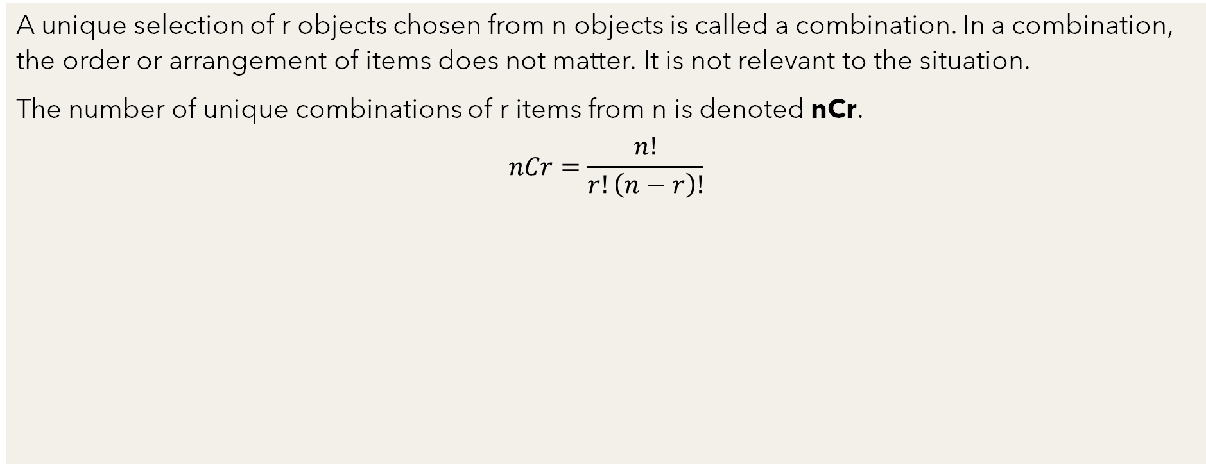
Combinations
A unique selection of r objects chosen from n objects is called a combination. In a combination, the order or arrangement of items does not matter. It is not relevant to the situation.
The number of unique combinations of r items from n is denoted nCr.
$$nCr=\frac{n!}{r!\left(n−r\right)!}$$
For example: Jack is preparing a fruit salad. He has the following in his pantry: pineapples, green apples, cherries, oranges, coconuts, and bananas. He wants to pick a total of four fruit types for the salad. How many unique combinations of fruit does he have to choose from for the recipe?
6C4 = 15

Slide 37
Combinations Practice
Sambhaji oversees 35 employees. He wants to select 2 people at random to receive a prize at the company picnic (the prize is the same for both people).
How many combinations of 2 people from 35 can be chosen?
What if 4 people didn’t show up to the picnic?
At Sambhaji’s company, 16 people work the night shift and 19 work the day shift. If 2 people are selected at random to win a prize, what is the probability that both work the night shift?
How many combinations of one night shift and one day shift workers are there?
What is the probability that if 2 winners are chosen, at least one of them will work the night shift?
What if the boss decides to award two different prizes ($200 and $100)? How would this change the problem?
Given the same n and the same r, will there always be more combinations or more permutations? Explain.

